Slide 1
Medicaid Coverage Retention
The 2027 Business Case
Preventing avoidable, procedural coverage loss under H.R.1 / OBBBA Medicaid work requirements
June 2026 · medicaid.atypical.global

Slide 2
The bottom line
Jan 1, 2027
80 hrs/mo
~1 in 4
$600M+
Federal enforcement
Work / activity rule
Lost coverage in Arkansas
Pledged — to eligibility, not outreach
Eligible people will lose Medicaid over paperwork, not eligibility. That is a fixable, fundable communications problem.
Medicaid Coverage Retention
medicaid.atypical.global

Slide 3
What changed: H.R.1 / OBBBA
● Signed July 4, 2025 — first nationwide Medicaid community-engagement (work) requirement
● Many expansion adults (19–64) must complete ~80 hrs/month of work, school, training, or service — and report it
● Renewal cycle for expansion adults cut from annual to every six months
● Enforcement begins January 1, 2027
Medicaid Coverage Retention
medicaid.atypical.global

Slide 4
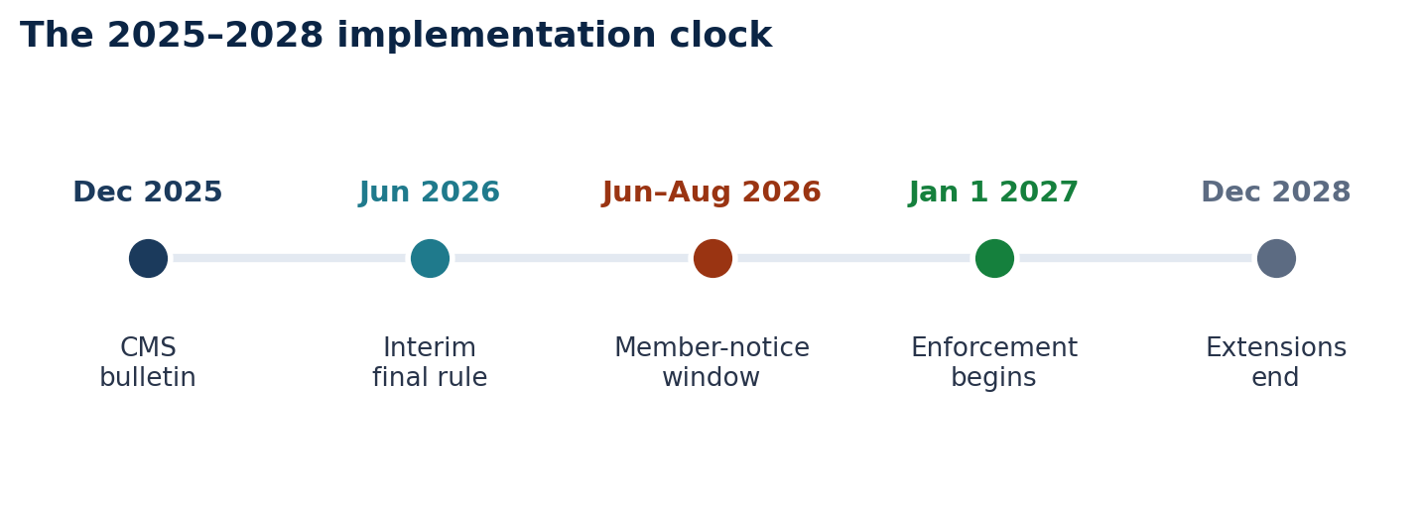
The dates that matter
The member-notice window (Jun–Aug 2026) is the action deadline. Procurement happens in 2026.
Medicaid Coverage Retention
medicaid.atypical.global

Slide 5
The new six-month renewal
● Redeterminations for expansion adults now twice a year, not once
● Doubles the administrative touchpoints where an eligible member can fall off
● Makes retention a permanent operating discipline — not a one-time 2027 event
Medicaid Coverage Retention
medicaid.atypical.global

Slide 6
Who is subject — and who is exempt
● Applies to the ACA Medicaid expansion adult population
● Exempt categories include: caregivers of a child <14, pregnant/postpartum, disabled/medically frail, AI/AN, SUD treatment, certain students, short-term hardship
● An exemption only protects a member the state can identify and document — itself a communication problem
Medicaid Coverage Retention
medicaid.atypical.global

Slide 7
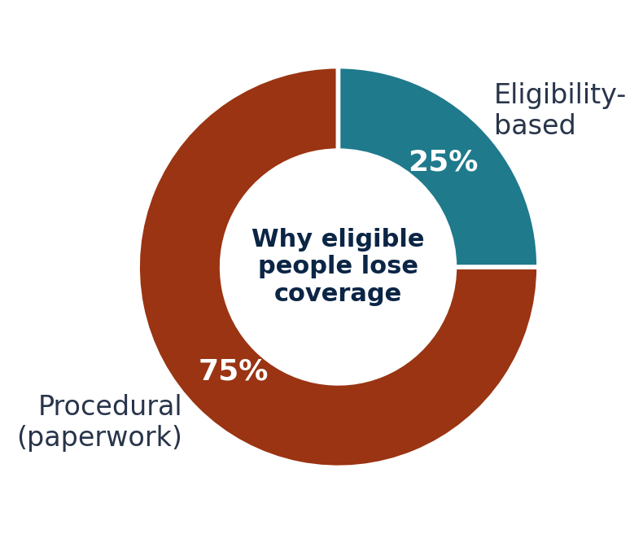
The core problem: procedural disenrollment
Most coverage loss is procedural — a paperwork failure, not an eligibility failure.
Medicaid Coverage Retention
medicaid.atypical.global

Slide 8
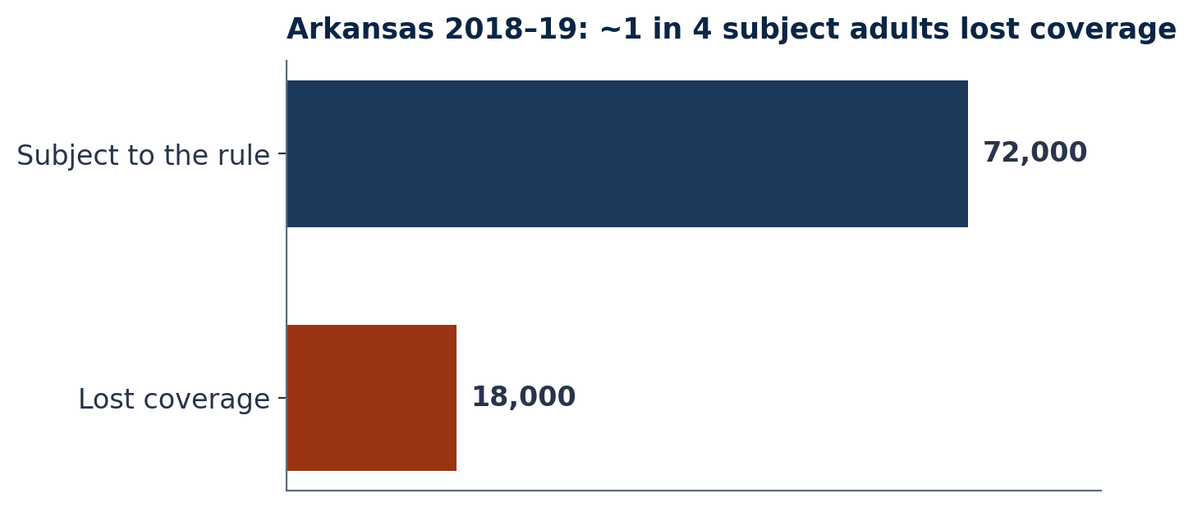
The Arkansas precedent
2018–19: ~18,000 lost coverage — about 1 in 4 subject adults — with no measurable employment gain.
Medicaid Coverage Retention
medicaid.atypical.global

Slide 9
The unwinding confirmed it at scale
● 2023–24 Medicaid unwinding: a large share of disenrollments were procedural, not eligibility-based
● States that automated renewals + invested in clear, multilingual outreach retained far more eligible members
● Ex-parte (automatic) renewals are associated with materially lower procedural-denial rates
Medicaid Coverage Retention
medicaid.atypical.global

Slide 10
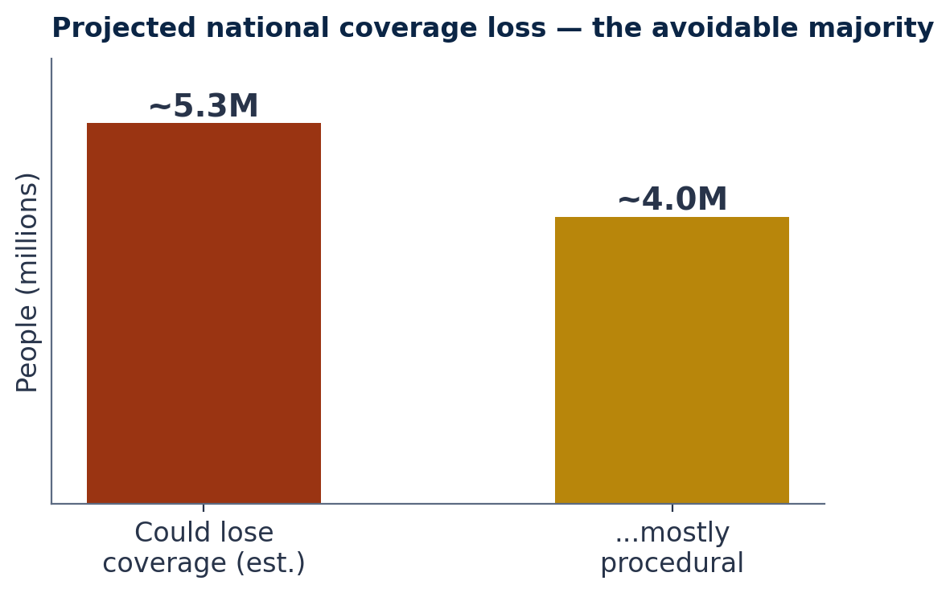
It scales now
Independent estimates project millions could lose coverage nationally — the avoidable majority procedural.
Medicaid Coverage Retention
medicaid.atypical.global

Slide 11
Market & population at risk
● 70M+ Americans on Medicaid; tens of millions in managed care
● Requirement applies across ~40 expansion states + DC
● Four buyer types: MCOs, state agencies, eligibility primes, and FQHCs/CBOs
Medicaid Coverage Retention
medicaid.atypical.global

Slide 12
Four buyers, one capability
● MCOs (~290) — feel churn as lost capitation; can contract fast
● State agencies (~40 + DC) — on the hook for the member-notice mandate
● Eligibility primes (~10) — need a member-comms layer they don't staff
● FQHCs / CBOs — trusted messengers absorbing the bad-debt cost
Medicaid Coverage Retention
medicaid.atypical.global

Slide 13
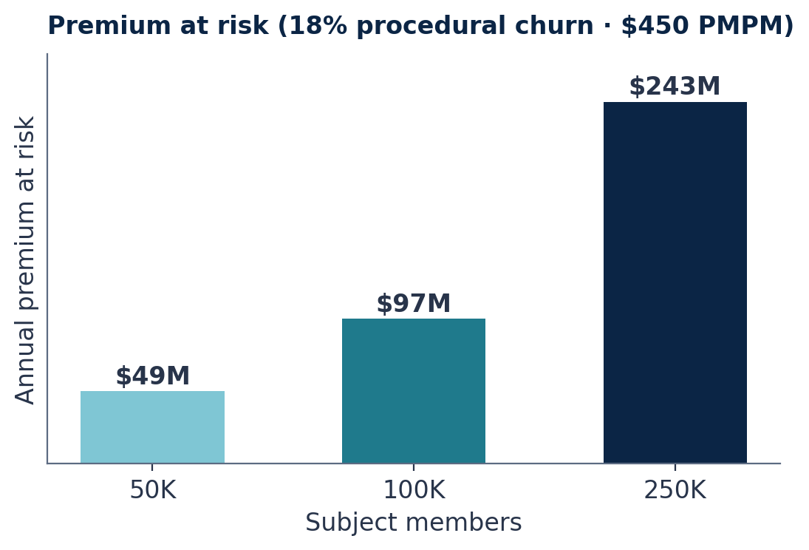
The financial impact: MCO economics
Every procedurally-disenrolled member is lost capitation, month after month.
Medicaid Coverage Retention
medicaid.atypical.global

Slide 14
State exposure
● FMAP exposure on wrongly-terminated eligible members
● Improper-termination liability + downstream uncompensated-care cost
● Political risk of mass coverage loss
● Administrative cost to stand up the requirement — tens of millions per state
Medicaid Coverage Retention
medicaid.atypical.global

Slide 15
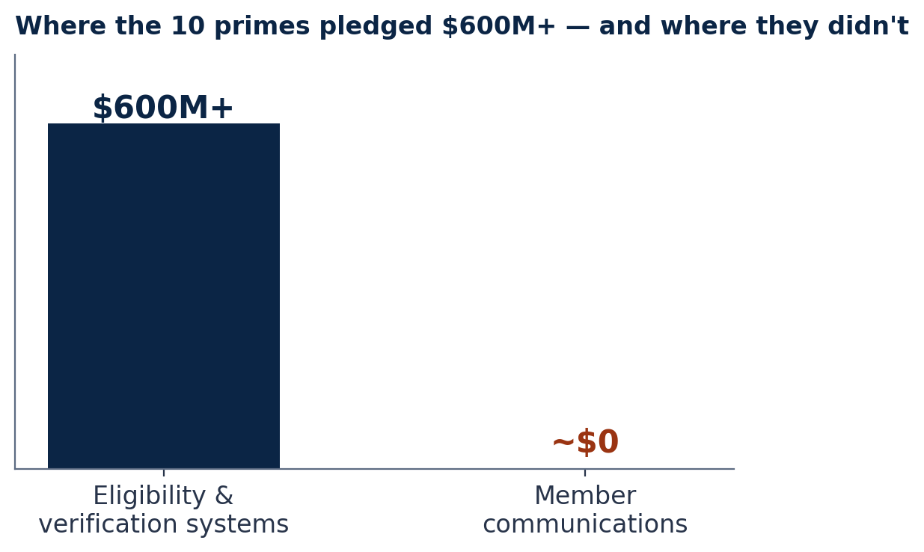
The vendor landscape
10 primes pledged $600M+ — concentrated on eligibility/verification, not member communications.
Medicaid Coverage Retention
medicaid.atypical.global

Slide 16
The unowned layer — our wedge
● We do NOT build eligibility or verification systems
● We are the member-engagement layer on top of them
● Plain-language, multilingual notices · exemption education · omnichannel outreach · measurement
● Sold to MCOs and states directly, or as a subcontractor to the primes (incl. BEP goals)
Medicaid Coverage Retention
medicaid.atypical.global

Slide 17
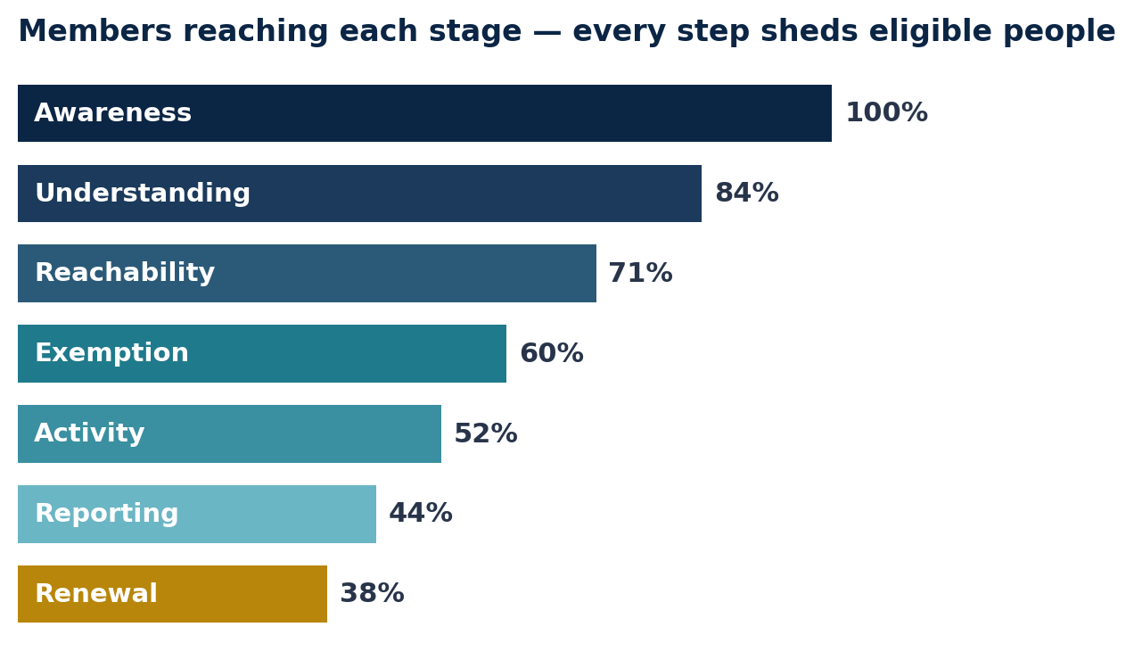
The member journey
Every administrative stage sheds eligible people. Retention is funnel optimization.
Medicaid Coverage Retention
medicaid.atypical.global

Slide 18
The compliance perimeter
● Plain language — 4th–6th grade reading level, one action per notice
● Language access — native-quality translation, not machine alone
● Accessibility — Section 508, IITAA, ADA, WCAG 2.1 AA (ADA Title II web rule effective Apr 24, 2026)
● TCPA consent for SMS/IVR · HHS marketing-rule aware · PHI-appropriate
Medicaid Coverage Retention
medicaid.atypical.global

Slide 19
The retention playbook
● 1 — Identify & segment: flag likely-exempt members from data; segment by language, geography, risk
● 2 — Communicate: plain-language, multilingual notices across mail/SMS/IVR/CBO
● 3 — Exemptions & reporting: prompt exemptions; make reporting simple; ex-parte first
● 4 — Measure: equity KPIs disaggregated by language, geography, disability
Medicaid Coverage Retention
medicaid.atypical.global

Slide 20
Channel-by-channel outreach
● Mail — the legal notice; fix addresses + readability + language
● SMS — highest response; TCPA-compliant consent & opt-out
● IVR & live phone — scale reminders; warm-transfer the hardest cases
● Web/portal — mobile-first, accessible, ex-parte renewal first
● Trusted messengers (CBO/FQHC) — reach the hardest-to-reach
Medicaid Coverage Retention
medicaid.atypical.global

Slide 21
Exemptions: the highest-leverage save
● Most avoidable loss among eligible people is unclaimed exemptions
● Pre-identify likely-exempt members from claims & cross-program data
● Prompt them and make documentation effortless
● SNAP/TANF data-matching is the single biggest automation
Medicaid Coverage Retention
medicaid.atypical.global

Slide 22
Language access & accessibility
● Spanish first, plus the locally-dominant languages; human translation + community review
● Telephonic & in-person interpretation at every live touchpoint
● 508 / IITAA / ADA / WCAG 2.1 AA; accessible alternatives to every PDF
● Design for low digital literacy and screen readers
Medicaid Coverage Retention
medicaid.atypical.global

Slide 23
Measurement: the KPI framework
● Procedural disenrollment rate — the headline number
● Notice reach · exemption capture · reporting completion · ex-parte renewal · reinstatement
● Equity gap — spread by language, geography, disability
● Baseline before the Jun–Aug 2026 window; track the first two 2027 cycles
Medicaid Coverage Retention
medicaid.atypical.global

Slide 24
Procurement & teaming: how to win
● State RFPs — watch the portals; bid early; lead with the deadline
● MCO direct — lead with premium-at-risk; price as a fraction of loss prevented
● Prime subcontracting — be the engagement sub; help meet BEP/diversity goals
● Awarded states are teaming targets, not dead ends
Medicaid Coverage Retention
medicaid.atypical.global

Slide 25
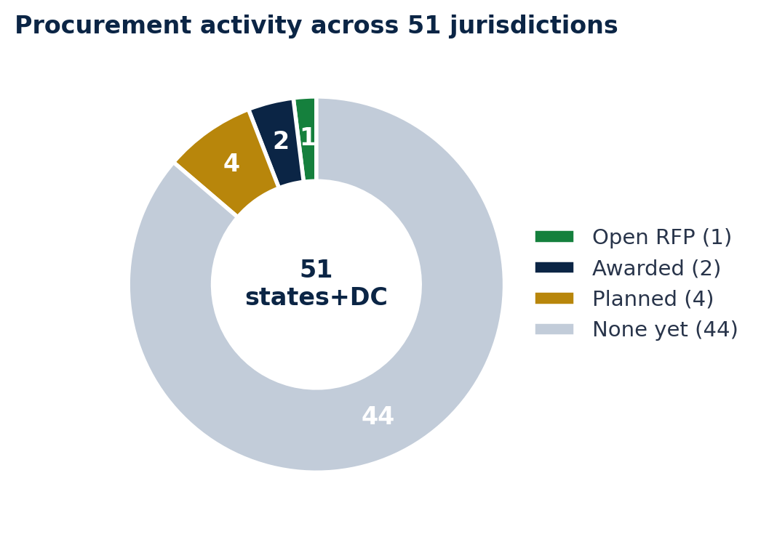
The 50-state RFP map
Most jurisdictions have NOT yet solicited member-comms work. Early movers and pre-positioning win.
Medicaid Coverage Retention
medicaid.atypical.global

Slide 26
Near-term targets
● Open RFP — Connecticut
● Awarded (teaming plays) — Arizona (AHCCCS), Illinois (HFS)
● Planned / budgeted — California (DHCS), Arkansas, Missouri, Ohio
● 44 states not yet solicited — the pre-positioning opportunity
Medicaid Coverage Retention
medicaid.atypical.global

Slide 27
The 90-day readiness roadmap
● Weeks 1–2 — quantify exposure; map the member journey; find the gaps
● Weeks 3–6 — build CMS-compliant, plain-language, multilingual notice set + SMS/IVR + exemption guides
● Weeks 7–10 — run outreach inside the Jun–Aug window; capture response & exemption data
● Weeks 11–13 — measure retention lift; convert to ongoing managed outreach
Medicaid Coverage Retention
medicaid.atypical.global

Slide 28
Why us
● Built solely for Medicaid coverage retention — not a general agency
● The rare mix: technology, Medicaid policy, and marketing in one team
● U.S.-led with native-Spanish production capacity
● Full delivery team stood up per engagement across policy, language, compliance, production
Medicaid Coverage Retention
medicaid.atypical.global

Slide 29
How to start
● Rapid Pack — CMS-compliant EN/ES notices, SMS/IVR scripts, exemption one-pagers in 2–3 weeks
● Readiness Audit — quantify exposure + a prioritized retention plan
● Managed Outreach — run the program end-to-end through the 2027 cycles
● State rules pack & briefing — deeper, source-cited, per state
Medicaid Coverage Retention
medicaid.atypical.global

Slide 30
Don't let eligible people lose Medicaid over paperwork.
medicaid.atypical.global
Talk to us about a state- or plan-specific readiness audit before the August notice window.

